Slide 1
Firms in Competitive Markets
CHAPTER 14
Notes:
N. Gregory Mankiw Principles Of Economics Eight Edition

Slide 2
What is a Competitive Market, Part 1
Competitive market
Perfectly competitive market
Market with many buyers and sellers
Trading identical products
Each buyer and seller is a price taker
Firms can freely enter or exit the market

Slide 3
What is a Competitive Market, Part 2
Firm in a competitive market
Tries to maximize profit
Profit
Total revenue minus total cost
Total revenue, TR = P ˣ Q
Price times quantity
Proportional to the amount of output

Slide 4
What is a Competitive Market, Part 3
Average revenue, AR = TR / Q
Total revenue divided by the quantity sold
Marginal revenue, MR = ∆TR / ∆Q
Change in total revenue from an additional unit sold
For competitive firms
AR = P
MR = P

Slide 5
Table 1 Total, Average, and Marginal Revenue for a Competitive Firm
(1) Quantity (Q) | (2) Price (P) | (3) Total Revenue (TR = P × Q) | (4) Average Revenue (AR = TR / Q) | (5) Marginal Revenue (MR = ∆TR / ∆Q)
1 gallon | $6 | $6 | $6
2 | 6 | 12 | 6 | $6
3 | 6 | 18 | 6 | 6
4 | 6 | 24 | 6 | 6
5 | 6 | 30 | 6 | 6
6 | 6 | 36 | 6 | 6
7 | 6 | 42 | 6 | 6
8 | 6 | 48 | 6 | 6

Slide 6
Profit Maximization, Part 1
Maximize profit
Produce quantity where total revenue minus total cost is greatest
Compare marginal revenue with marginal cost
If MR > MC: increase production
If MR < MC: decrease production
Maximize profit where MR = MC

Slide 7
Table 2 Profit Maximization: A Numerical Example
(1) Quantity (Q) | (2) Total Revenue (TR) | (3) Total Cost (TC) | (4) Profit (TR - TC) | (5) Marginal Revenue (MR = ∆TR / ∆Q) | (6) Marginal Cost (MC = ∆TR / ∆Q) | (7) Change in Profit (MR - MC)
0 gallons | $0 | $3 | -$3
1 | 6 | 5 | 1 | $6 | $2 | $4
2 | 12 | 8 | 4 | 6 | 3 | 3
3 | 18 | 12 | 6 | 6 | 4 | 2
4 | 24 | 17 | 7 | 6 | 5 | 1
5 | 30 | 23 | 7 | 6 | 6 | 0
6 | 36 | 30 | 6 | 6 | 7 | -1
7 | 42 | 38 | 4 | 6 | 8 | -2
8 | 48 | 47 | 1 | 6 | 9 | -3

Slide 8
Profit Maximization, Part 2
The marginal-cost curve and the firm’s supply decision
MC curve is upward sloping
ATC curve is U-shaped
MC curve crosses the ATC curve at the minimum of ATC curve
The price line is horizontal: P = AR = MR

Slide 9
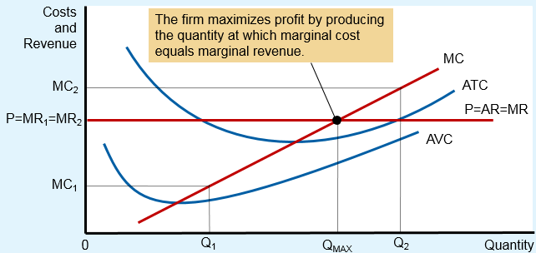
Figure 1 Profit Maximization for a Competitive Firm
This figure shows the marginal-cost curve (MC), the average-total-cost curve (ATC), and the average-variable-cost curve (AVC). It also shows the market price (P), which for a competitive firm equals both marginal revenue (MR) and average revenue (AR).
At the quantity Q₁, MR₁ > MC₁, so raising production increases profit.
At the quantity Q₂, MC₂ > MR₂, so reducing production increases profit.
The profit-maximizing quantity Q_{MAX} is found where the horizontal line representing the price intersects the marginal-cost curve.

Slide 10
Profit Maximization, Part 3
Rules for profit maximization:
If MR > MC, firm should increase output
If MC > MR, firm should decrease output
If MR = MC, profit-maximizing level of output
Marginal-cost curve
Determines the quantity of the good the firm is willing to supply at any price
Is the supply curve

Slide 11
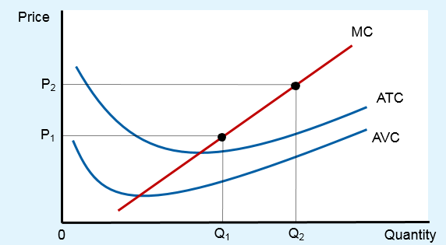
Figure 2 Marginal Cost as the Competitive Firm’s Supply Curve
An increase in the price from P₁ to P₂ leads to an increase in the firm’s profit-maximizing quantity from Q₁ to Q₂. Because the marginal-cost curve shows the quantity supplied by the firm at any given price, it is the firm’s supply curve.

Slide 12
Profit Maximization, Part 4
Shutdown
Short-run decision not to produce anything
During a specific period of time
Because of current market conditions
Firm still has to pay fixed costs
Exit
Long-run decision to leave the market
Firm doesn’t have to pay any costs

Slide 13
Profit Maximization, Part 5
The firm’s short-run decision to shut down
TR = total revenue
VC = variable costs
Firm’s decision:
Shut down if TR < VC (or P < AVC)
Competitive firm’s short-run supply curve
The portion of its marginal-cost curve
That lies above average variable cost

Slide 14
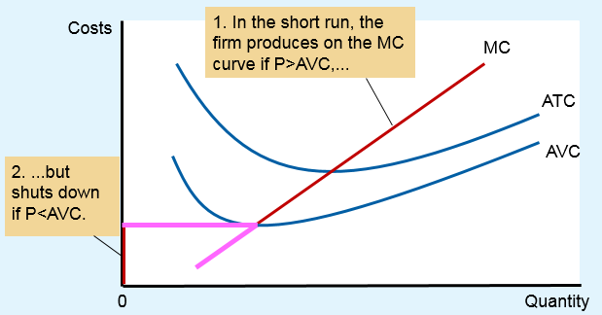
Figure 3 The Competitive Firm’s Short-Run Supply Curve
In the short run, the competitive firm’s supply curve is its marginal-cost curve (MC) above average variable cost (AVC). If the price falls below average variable cost, the firm is better off shutting down temporarily.

Slide 15
Profit Maximization, Part 6
Sunk cost
A cost that has already been committed and cannot be recovered
Should be ignored when making decisions
“Don’t cry over spilt milk”
“Let bygones be bygones”
In the short run, fixed costs are sunk costs

Slide 16

Near-empty restaurants & off-season miniature golf, Part 1
Restaurant – stay open for lunch?
Fixed costs: not relevant; are sunk costs in short run
Variable costs, VC: relevant
Shut down if revenue from lunch < VC
Stay open if revenue from lunch > VC
Staying open can be profitable, even with many tables empty.

Slide 17
Near-empty restaurants & off-season miniature golf, Part 2
Operator of a miniature-golf course
Ignore fixed costs
Shut down if
Revenue < variable costs
Stay open if
Revenue > variable costs

Slide 18
Profit Maximization, Part 7
Firm’s long-run decision
Exit the market if
Total revenue < total costs; TR < TC (same as: P < ATC)
Enter the market if
Total revenue > total costs; TR > TC (same as: P > ATC)
Competitive firm’s long-run supply curve
The portion of its marginal-cost curve that lies above average total cost

Slide 19
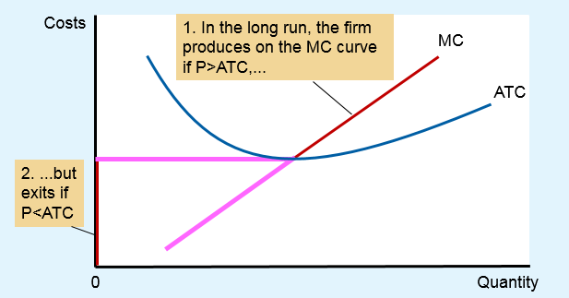
Figure 4 The Competitive Firm’s Long-Run Supply Curve
In the long run, the competitive firm’s supply curve is its marginal-cost curve (MC) above average total cost (ATC). If the price falls below average total cost, the firm is better off exiting the market.

Slide 20
Profit Maximization, Part 8
Measuring profit
If P > ATC
Profit = TR – TC = (P – ATC) ˣ Q
If P < ATC
Loss = TC - TR = (ATC – P) ˣ Q
= Negative profit

Slide 21
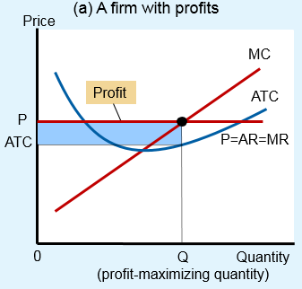
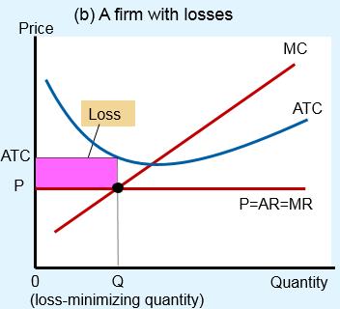
Figure 5 Profit as the Area between Price and Average Total Cost
The area of the shaded box between price and average total cost represents the firm’s profit. The height of this box is price minus average total cost (P – ATC), and the width of the box is the quantity of output (Q). In panel (a), price is above average total cost, so the firm has positive profit. In panel (b), price is less than average total cost, so the firm incurs a loss.

Slide 22
Supply Curve, Part 1
Short run: market supply with a fixed number of firms
Short run: number of firms is fixed
Each firm supplies quantity where P = MC
For P > AVC: supply curve is MC curve
Market supply
Add up quantity supplied by each firm

Slide 23
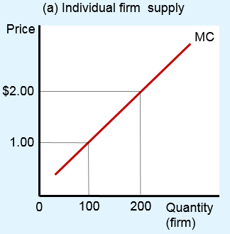
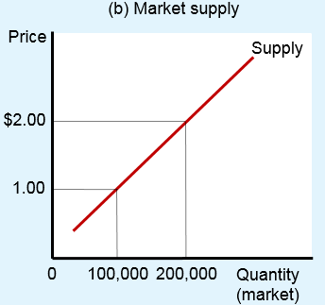
Figure 6 Short-Run Market Supply
In the short run, the number of firms in the market is fixed. As a result, the market supply curve, shown in panel (b), reflects the individual firms’ marginal-cost curves, shown in panel (a). Here, in a market of 1,000 firms, the quantity of output supplied to the market is 1,000 times the quantity supplied by each firm

Slide 24
Supply Curve, Part 2
Long run
Firms can enter and exit the market
If P > ATC, firms make positive profit
New firms enter the market
If P < ATC, firms make negative profit
Firms exit the market

Slide 25
Supply Curve, Part 3
Long run
Process of entry and exit ends when
Firms still in market make zero economic profit (P = ATC)
Because MC = ATC: Efficient scale
Long run supply curve is perfectly elastic
Horizontal at minimum ATC

Slide 26
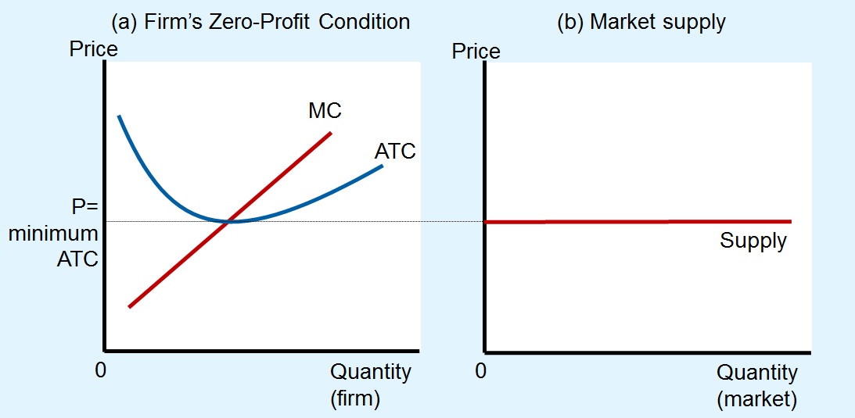
Figure 7 Long-Run Market Supply
In the long run, firms will enter or exit the market until profit is driven to zero. As a result, price equals the minimum of average total cost, as shown in panel (a). The number of firms adjusts to ensure that all demand is satisfied at this price. The long-run market supply curve is horizontal at this price, as shown in panel (b).

Slide 27
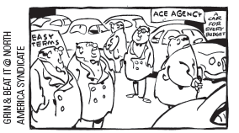
Supply Curve, Part 4
Why do competitive firms stay in business if they make zero profit?
Profit = total revenue – total cost
Total cost includes all opportunity costs
Zero-profit equilibrium
Economic profit is zero
Accounting profit is positive
“We’re a nonprofit organization - we don’t intend to be, but we are!”

Slide 28
Supply Curve, Part 5
Market in long run equilibrium
P = minimum ATC
Zero economic profit
Increase in demand
Demand curve shifts outward
Short run
Higher quantity
Higher price: P > ATC, positive economic profit

Slide 29
Supply Curve, Part 6
Positive economic profit in short run
Long run – firms enter the market
Short run supply curve – shifts right
Price – decreases back to minimum ATC
Quantity – increases
Because there are more firms in the market
Efficient scale

Slide 30
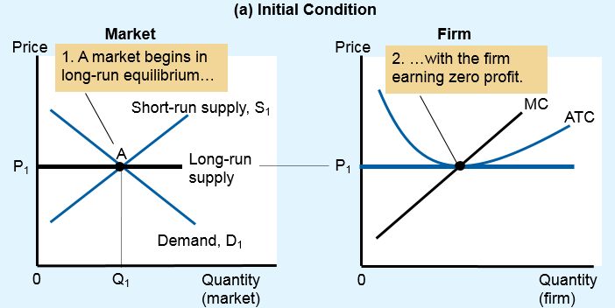
Figure 8 An Increase in Demand in the Short Run and Long Run (a)
The market starts in a long-run equilibrium, shown as point A in panel (a). In this equilibrium, each firm makes zero profit, and the price equals the minimum average total cost.

Slide 31
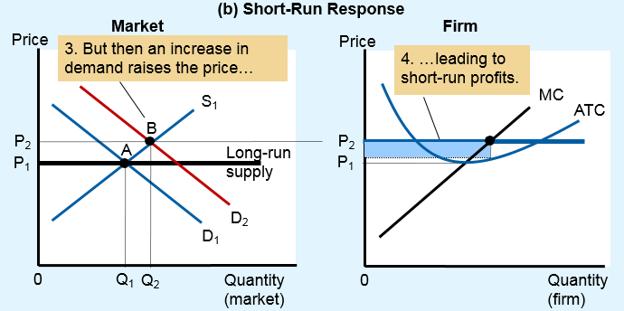
Figure 8 An Increase in Demand in the Short Run and Long Run (b)
Panel (b) shows what happens in the short run when demand rises from D₁ to D₂. The equilibrium goes from point A to point B, price rises from P₁ to P₂, and the quantity sold in the market rises from Q₁ to Q₂. Because price now exceeds average total cost, each firm now makes a profit, which over time encourages new firms to enter the market.

Slide 32
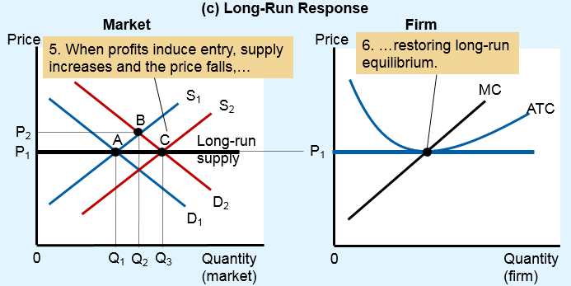
Figure 8 An Increase in Demand in the Short Run and Long Run (c)
This entry shifts the short-run supply curve to the right from S₁ to S₂, as shown in panel (c). In the new long-run equilibrium, point C, price has returned to P₁ but the quantity sold has increased to Q₃. Profits are again zero, and price is back to the minimum of average total cost, but the market has more firms to satisfy the greater demand.

Slide 33
Supply Curve, Part 7
Long-run supply curve might slope upward
Some resource used in production may be available only in limited quantities
Increase in quantity supplied – increase in costs – increase in price
Firms may have different costs
Some firms earn profit even in the long run
Long-run supply curve
More elastic than short-run supply curve

